Slide 1
Bridge to Success: Using Data to Improve Student Success Early Predictors of High School Graduation, Postsecondary Attendance, and Postsecondary Completion Oded Gurantz, John W. Gardner Center for Youth and Their Communities, Stanford University
Stanford University and San Francisco Unified School District Partnership
April 22, 2011

Slide 2
Agenda
Examine educational trajectories of SFUSD students
Review subsequent policy and programmatic changes resulting from initial analysis
Discuss current structure of Bridge to Success (BtS) initiative
Examine early warning indicators for incoming 9th grade students and discuss potential actions

Slide 3
Project Background
San Francisco received a Bill & Melinda Gates Foundation “Communities Learning in Partnership” (CLIP) one-year planning grant in 2009
Mayor’s Office of Interagency Planning brings together SFUSD, City College of San Francisco (CCSF), and key community organizations to “double the number of students with a workplace applicable postsecondary credential by 2020”
John W. Gardner Center received initial data transfer in November 2009

Slide 4
Data Sources
SFUSD: Administrative data (e.g. demographics, course transcripts, standardized tests)
National Student Clearinghouse (NSC): Attendance and completion dates for (virtually) all domestic two- and four-year institutions
CCSF: Administrative data (e.g. course transcripts, placement exams, transfer and degree completion dates)

Slide 5
SFUSD Student Progress 2000-01 Cohort of First-Time Ninth Grade Students

Slide 6
Cumulative Student Progress 2000-01 Cohort of First-Time Ninth Grade Students
PSP committed to using data to inform their process, but no data linking SFUSD to CCSF exist
The YDA:
Links individual-level data on youth across city, county, school district, and non-profit agencies in a community
Works closely with community partners to identify cross-agency research questions that no one agency alone could answer and address important needs in the community
Presents research findings to community partners and supports partners to understand resulting analyses
Focuses on actionable steps community can take to improve youth outcomes and supports the process for doing so

Slide 7
Five-Year Bachelor Degree Completion Rates 2000-01 Cohort of First-Time Ninth Grade Students

Slide 8
Postsecondary Completion at CCSF
30% of all SFUSD graduates attended CCSF
Approximately one-third received an associates degree, workforce-applicable certificate, or transferred to a four-year institution within five years
HS characteristics: Better academics (GPA, CST, math courses taken) associated with higher completion rates
CCSF characteristics: Enrolling full-time and prompt enrollment in key courses was associated with higher completion rates

Slide 9
Data-Driven Policy and Programmatic Improvements
CCSF providing priority enrollment program for SFUSD graduates
CCSF math department accepting Early Assessment Program (EAP) results in lieu of placement exam
Professional Learning Communities between SFUSD and CCSF staff to investigate alignment between English and math curriculum

Slide 10
Initial Bridge to Success Feedback
Does this analysis of SFUSD student pathways raise any questions or suggest any recommendations to SFUSD or CCSF policies?

Slide 11
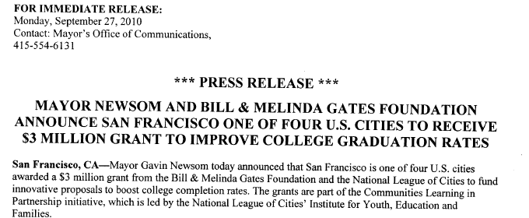
San Francisco Received Bridge to Success (BtS) Implementation Grant

Slide 12

Current Bridge to Success Structure
Team | Connection Point
Teaching | SFUSD Core Curriculum CCSF Education Master Plan and English and Math Pathway redesign
Counseling | SFUSD Restorative Practices, College/Career readiness, Special Ed Redesign CCSF DPSP, excellence in support services and counseling
Transitions | New work to fill gap identified in planning phase
Outreach | SFUSD Parent Engagement, Restorative Practices CCSF Communication and Information
Workforce/ Pathways | DCYF-SFUSD School Partner Model OEWD Sector Academies SFUSD Core Curriculum, Career Academies, Dual Enrollment CCSF Career paths & certificates
Each group can request data analysis from the “Data” team, pending joint agency approval

Slide 13
Example: Summer Bridge
Transitions team interested in a “Summer Bridge” program to help students transition into CCSF
Students who did not attend a postsecondary institution had low high school attendance rates, were more likely to be English Learners, and rarely earned CCSF credits during high school
RFP for “Summer Bridge” program included research brief detailing key findings

Slide 14
Example: Early Warning Indicators (EWI)
High schools staff want to know on the first day of school which students might need additional support
Key Characteristics of Indicator System:
Indicators are easily understood
Appropriate number of students are identified
Indicators can identify students but may not help provide solutions

Slide 15
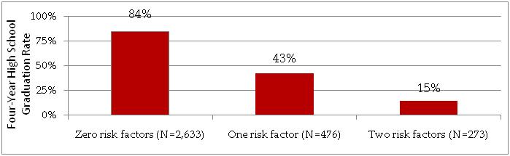
EWI - Main Findings
* Analysis combined data from two cohorts of students who were enrolled in SFUSD both semesters of eighth graders and then entered ninth grade during the fall semester of the 2005-06 and 2006-07 school years. Results were then averaged to provide SFUSD a picture of how indicators would impact a typical school year. This resulted in a cohort of 3,382 students who had a four-year high school graduation rate of 72.9%.
Two key indicators using 8th grade data:
GPA less than 2.0
Attendance Rate less than 87.5%

Slide 16
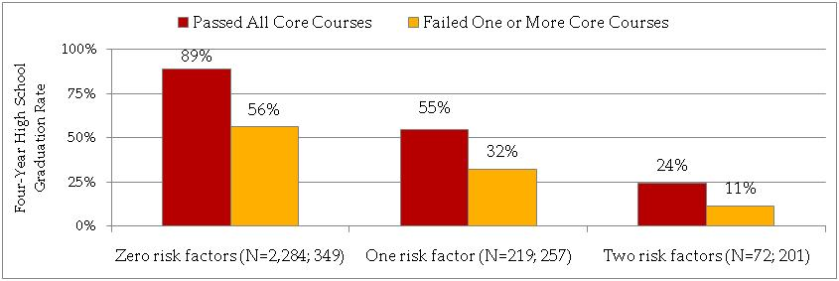
EWI - Why Does Identifying Students Matter?
Core courses include Math, English, Social Studies, and Science. Passing indicates a grade of “D” or higher.
Passing all core courses in the first semester of 9th grade significantly increases graduation rates
Almost half of students who entered with one risk factor passed all their core courses

Slide 17
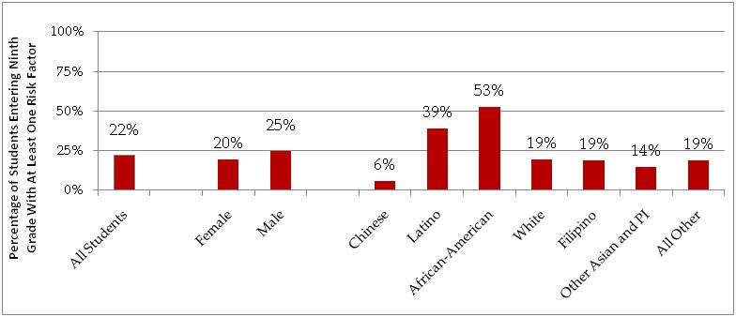
EWI - Percentage of Students Entering 9th Grade With At Least One Risk Factor

Slide 18
EWI - School Results
School Type | Schools | Size of 9th Grade Class* | Percentage of Students With a Risk Factor
I. Large | Galileo, Lincoln, Washington | ~500 | 20%
II. Medium | Balboa, Burton | ~250 | 25%
III. Small (Less Risk Factor Students) | Arts & Sciences, Marshall, Wallenberg, SOTA | ~100 | 30%
IV. Small (More Risk Factor Students) | ISA, June Jordan, Mission, O'Connell | ~100 | 50%
* Only includes first-time 9th grade students who were enrolled both semesters of 8th grade in SFUSD the previous year

Slide 19
Key Questions
What role can central office, school staff (e.g. principals, teachers, counselors) and non-school staff (e.g. parents, external partners) play in assisting or monitoring these students?
What strategies do schools currently use for “at-risk” students? Given the differences in student populations across high schools, do schools need to adopt different strategies?
What (additional) supports could help schools effectively assist these students?

Slide 20
Next Steps for Data Team
Working team data requests (e.g. Teaching team and alignment of math courses)
Additional data analyses (e.g. understanding student dropoff and completion rates at two- and four-year institutions)
Incorporation of data from additional partners
Development of San Francisco research consortium

